Slide 1
PERFORMING ARTS
DANCE

Slide 2
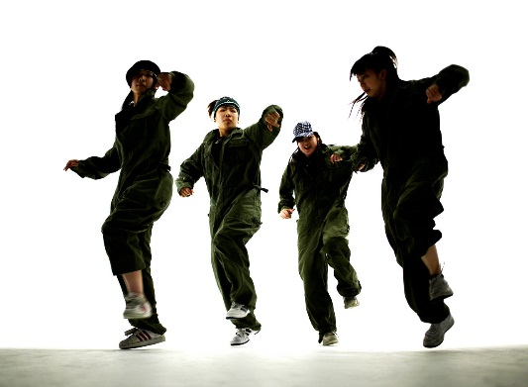
Learning Objective
To Warm up effectively in groups demonstrating that you can participate in an effective warm up showing focus, energy and determination.
Continue to learn the street dance routine focusing on timing, pace and
Technique by developing your
Movement memory

Slide 3
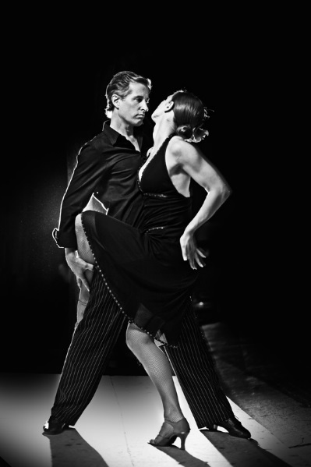
Success Criteria
Step 3
Can focus in the warm and identify some pulse raisers.
Can reproduce the taught routine with a few errors.
Step 4
Will focus and put effort in throughout the lessons and be able to identify the 3 sections of the warm up.
Will perform the routine with energy and focus.
Step 5.
Will concentrate and perform to the best of their ability throughout the lesson and work hard to warm up effectively.
Will perform with focus and accuracy of movement and always be keen to improve.
Step 6
Will be a role model to the group, work hard at all times and be proactive in asking and answering questions.
Will take a leadership role when rehearsing and help others to perform the routine.

Slide 4

When the number is called out you must perform the movement
1-jump
2- turn
3-stop
4-go
5-high
6-low

Slide 5
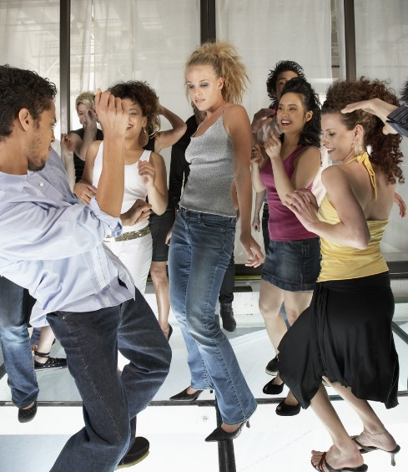
KEY WORDS
ACTION-WHAT
DYNAMIC-HOW
SPACE-WHERE
RELATIONSHIPS-WHO
RHYTHM-TIMING
FOCUS
ISOLATION
TECHNIQUE

Slide 6
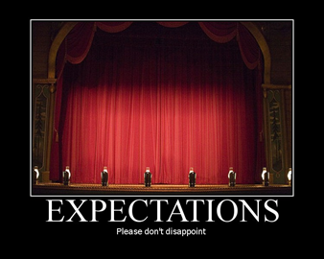

EXPECTATIONS
BE RESPECTFUL OF OTHERS IN THE CLASS.
TRY YOUR HARDEST AT ALL TIMES.
LISTEN TO FEEDBACK AND USE THIS CONSTRUCTIVELY TO IMPROVE YOUR PERFORMANCE.
LISTEN TO THE TEACHER AT ALL TIMES.
BE ABLE TO WORK AS A GROUP AND INDEPENDENTLY.
BE CREATIVE.
USE THE STAGE EFFECTIVELY.
LISTEN TO YOUR PEERS IDEAS

Slide 7

WARM UP
Last lesson you created your own warm ups.
You are now going to warm up independently
Showing that you are an effective participator,
You are aware of the demands for a warm up and
Can focus.

Slide 8
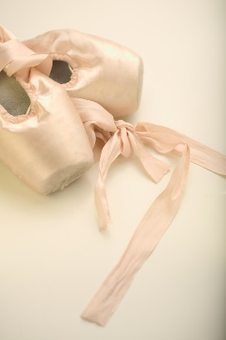
REMINDER: 5 BASIC ACTIONS
The 5 basic actions are
Jump
Hop
Travel
Stillness/gesture
Turn/rotate
You have 5 minutes to create an interesting jump, hop and turn.
Now put them together- what does transition mean?

Slide 9
STREET DANCE
In the routine you now need to focus on your execution and performance of movements. What does this mean? Discuss
What are the key performance skills
Needed? You will be performing next
Lesson so use your rehearsal to prepare.
REMEMBER TO COUNT!

Slide 10
PLENARY
What are the key elements of the dance?
What will you need to demonstrate next week in performance?

